Slide 1
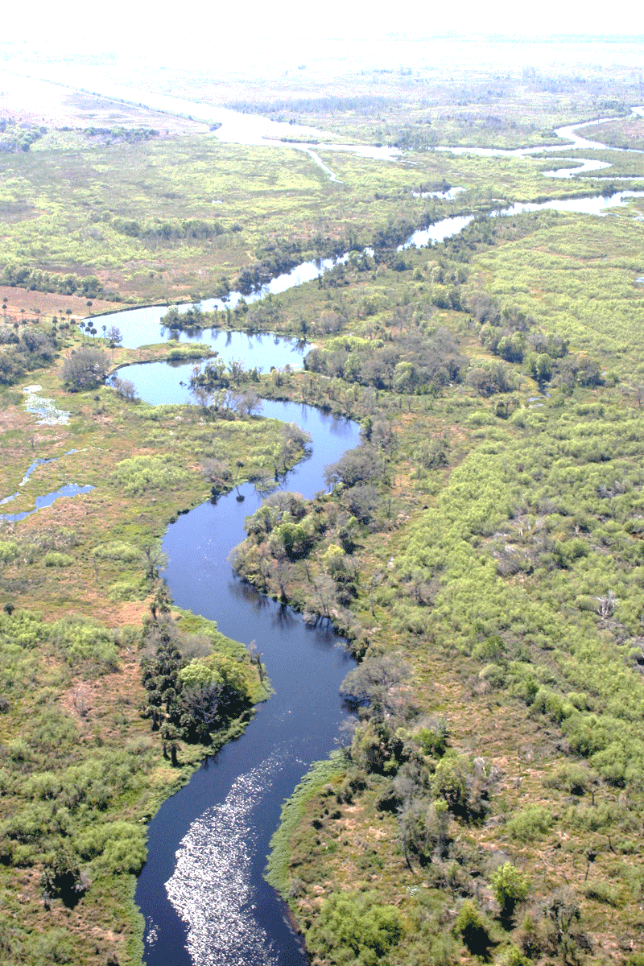
Colorado Basin River Analysis
Colorado Basin Team: Jerry Brooke, Karr Davis, Bruce Jones, Shubh Patel
February 2023
This Photo by Unknown Author is licensed under CC BY-SA-NC

Slide 2
Colorado River Basin (CRB) Analysis
DRAFT
Topic
The final project topic is the Colorado River Basin. The reason the Colorado River was selected is due to the fact that it provides water to a number of states in the Southwest and due the severe droughts in recent years has led to supply and demand challenges. We are interested in how the Rocky Mountain snowpacks and the water levels of Lake Mead and Lake Powell may impact future drought levels.
Data Description:
The data for the CRB analysis will consist of
Water levels for Lake Mead and Lake Powell (https://www.usbr.gov/uc/water/hydrodata/)
Colorado Rockies snowpack (https://www.nrcs.usda.gov/Internet/WCIS/AWS_PLOTS/basinCharts/POR/WTEQ/assocHUCco_8/colorado_headwaters.html)
Geographical data of the West Region
Target Question(s):
Do the Rocky Mountain snowpacks have a relationship to future Colorado River Basin levels?
Is there a significant chance of a severe drought levels for the West Region in the future?

